Slide 1

Evaluating the Effectiveness of Phishing Reports on Twitter
Sayak Saha Roy, Unique Karanjit, and Shirin Nilizadeh
The University of Texas at Arlington
APWG ECRIME 2021 – SYMPOSIUM ON ELECTRONIC CRIME RESEARCH

Slide 2
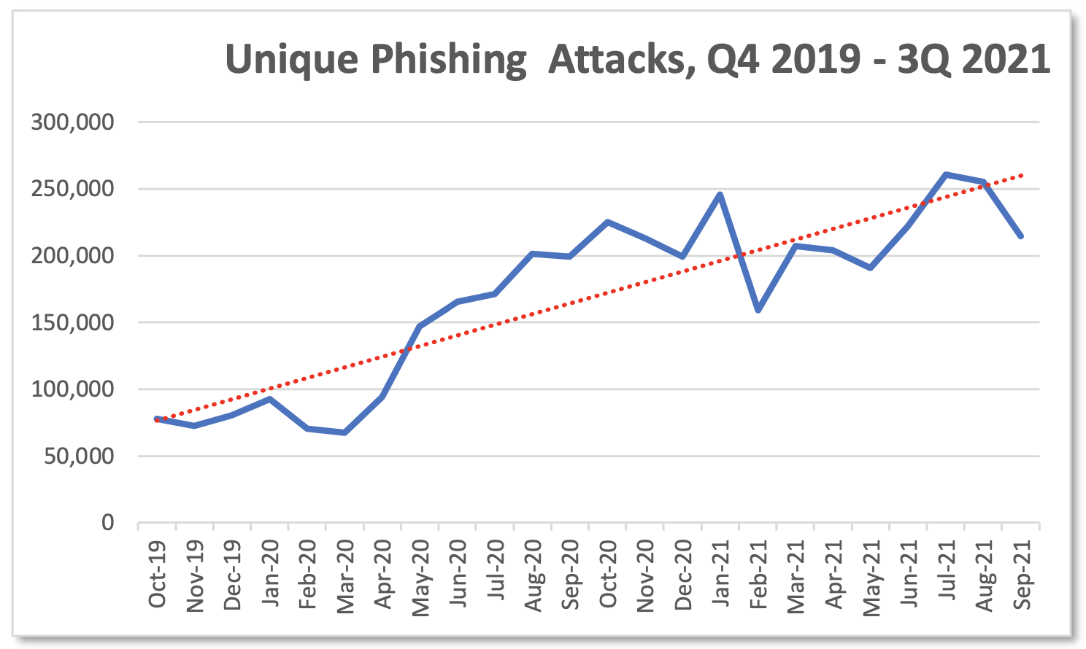
Phishing is an ever increasing threat
https://docs.apwg.org/reports/apwg_trends_report_q3_2021.pdf

Slide 3
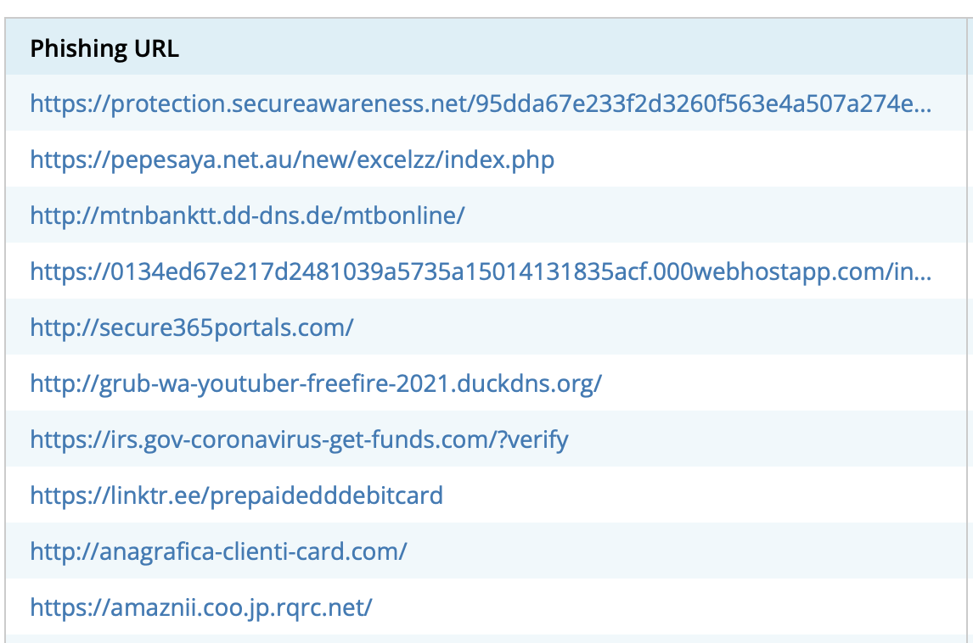
Blocklisting is a prominent approach for detecting phishing threats
Phishing blocklists:
Crawling or manual reporting.
Provide information about phishing website.
Used by organizations for content filtering.
Used by anti-phishing tools/browsers.
Notes:
To be changed
Two approaches:
Automated crawlers
Manual reporting

Slide 4
But phishing blocklists are not perfect
Often slow, upto 9 hours if not longer.
Can be deceived by evasion approaches, such as cloaking.
Constant need to improve and consolidate with new phishing information.
Oest, Adam, et al. "Sunrise to sunset: Analyzing the end-to-end life cycle and effectiveness of phishing attacks at scale." 29th {USENIX} Security Symposium ({USENIX} Security 20). 2020.
Notes:
Because phishing is such a dangerous threat, there is a constant need to

Slide 5

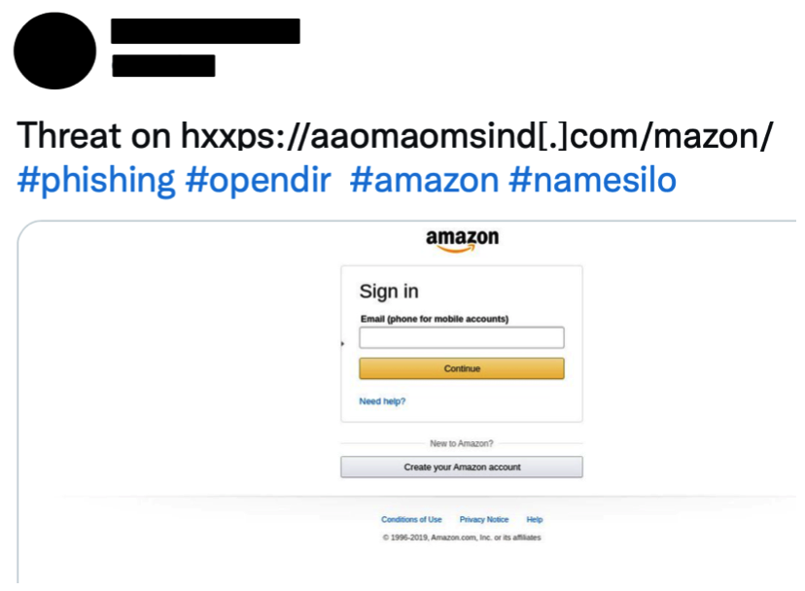
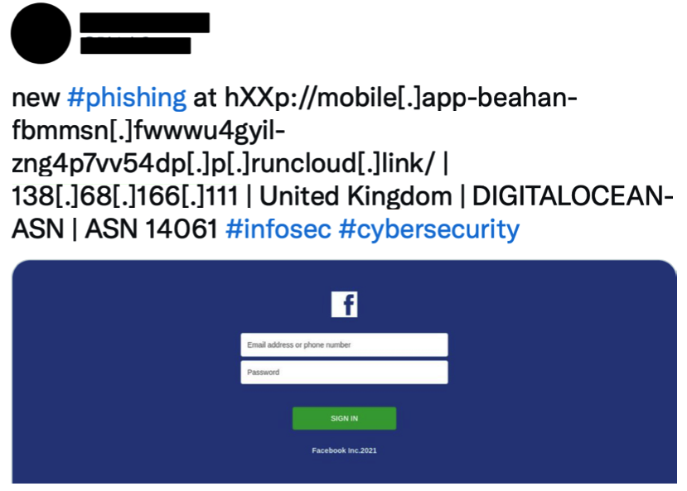
Our work looks at a new source of acquiring phishing information
Phishing reports shared on Twitter.
Notes:
Another slide we explain shortcomings of phishing blocklists.

Slide 6
Research Goal
How do these reports compare to other phishing blocklists?
Comparison with OpenPhish and PhishTank
Information provided, phishing coverage, correctness
Can these reports enhance prevalent phishing blocklists?
Notes:
Maybe have a screenshot of http defanged to hxxp

Slide 7
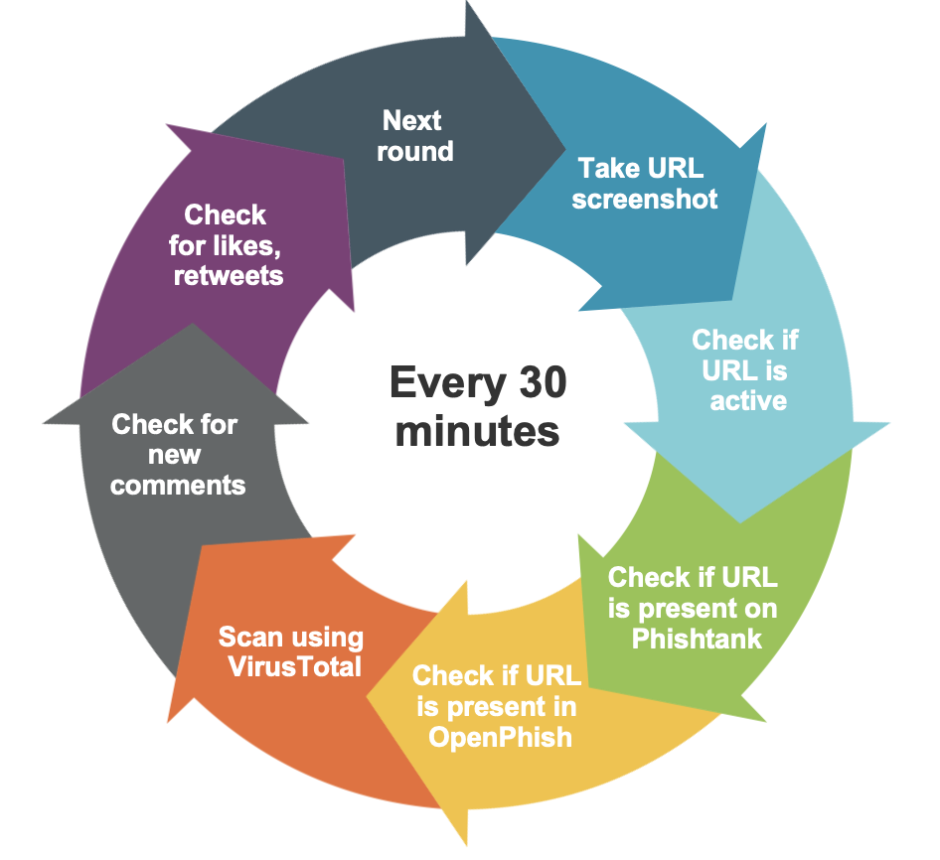
Data collection
#phishing, #scam, defanged URLs (hxxp/hxxps)
16.4k tweets containing 11.1k unique URLs shared by 701 users
URLs collected, defanged and analyzed every 30 mins from June to August 2021

Slide 8
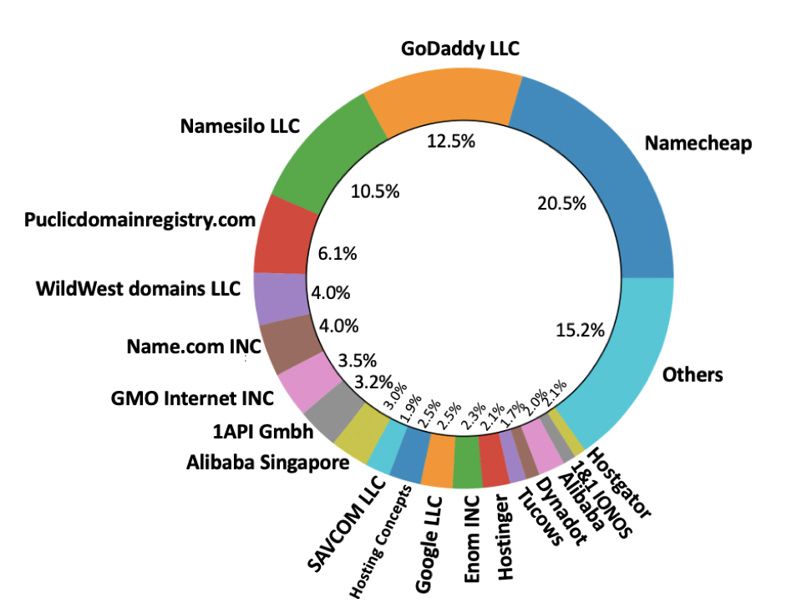
These URLs cover 203 unique domains!

Slide 9
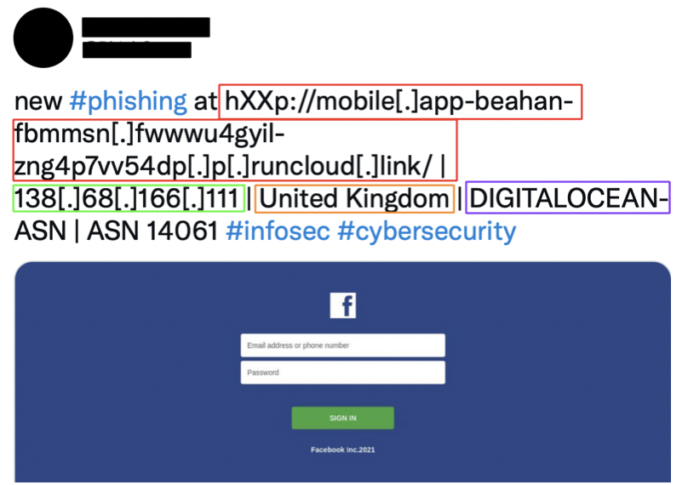
Information shared by these reports
The Phishing URL
The IP Address
The hosting domain
Screenshot of the URL

Slide 10
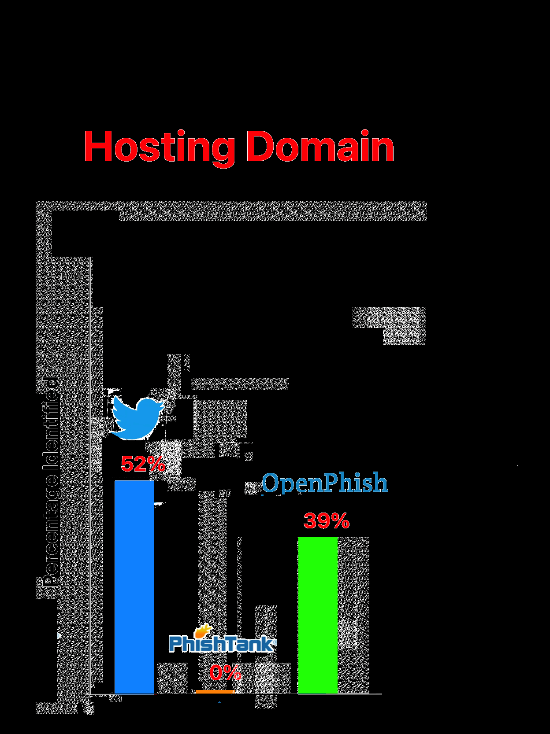
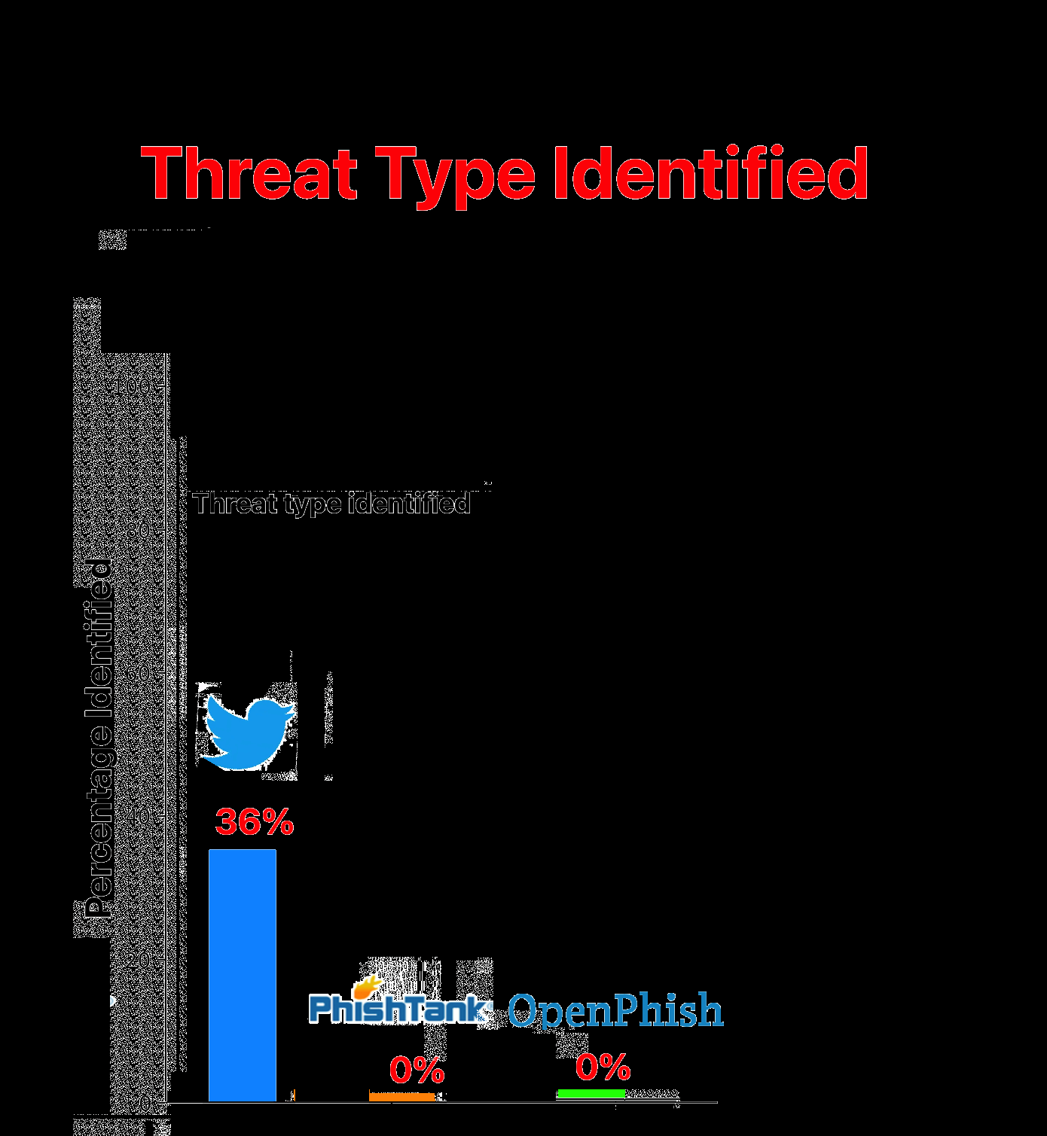
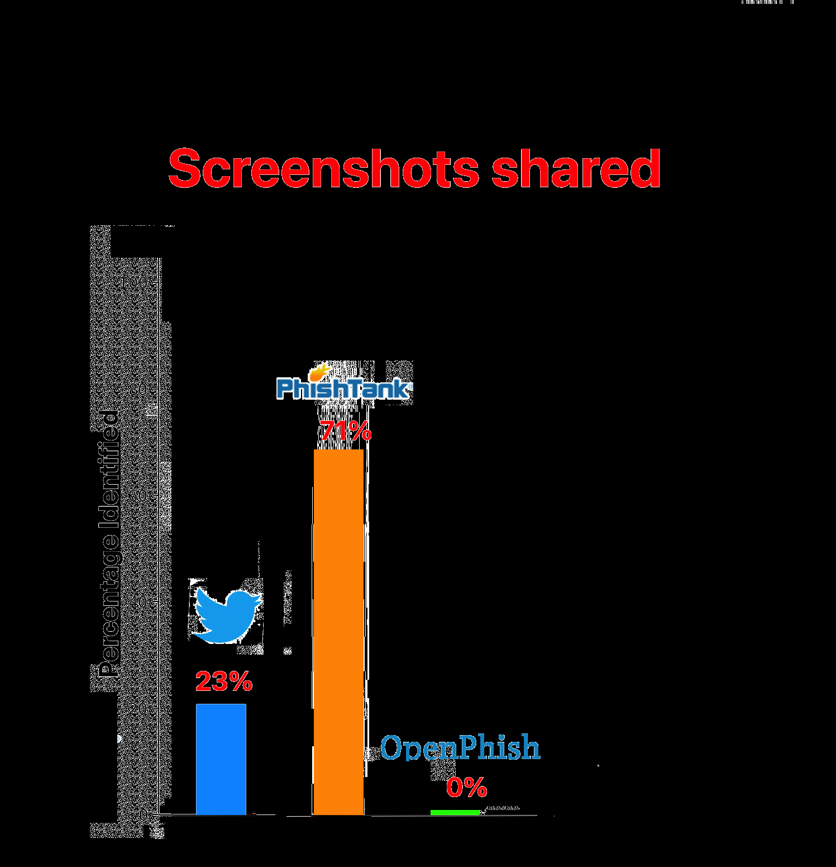
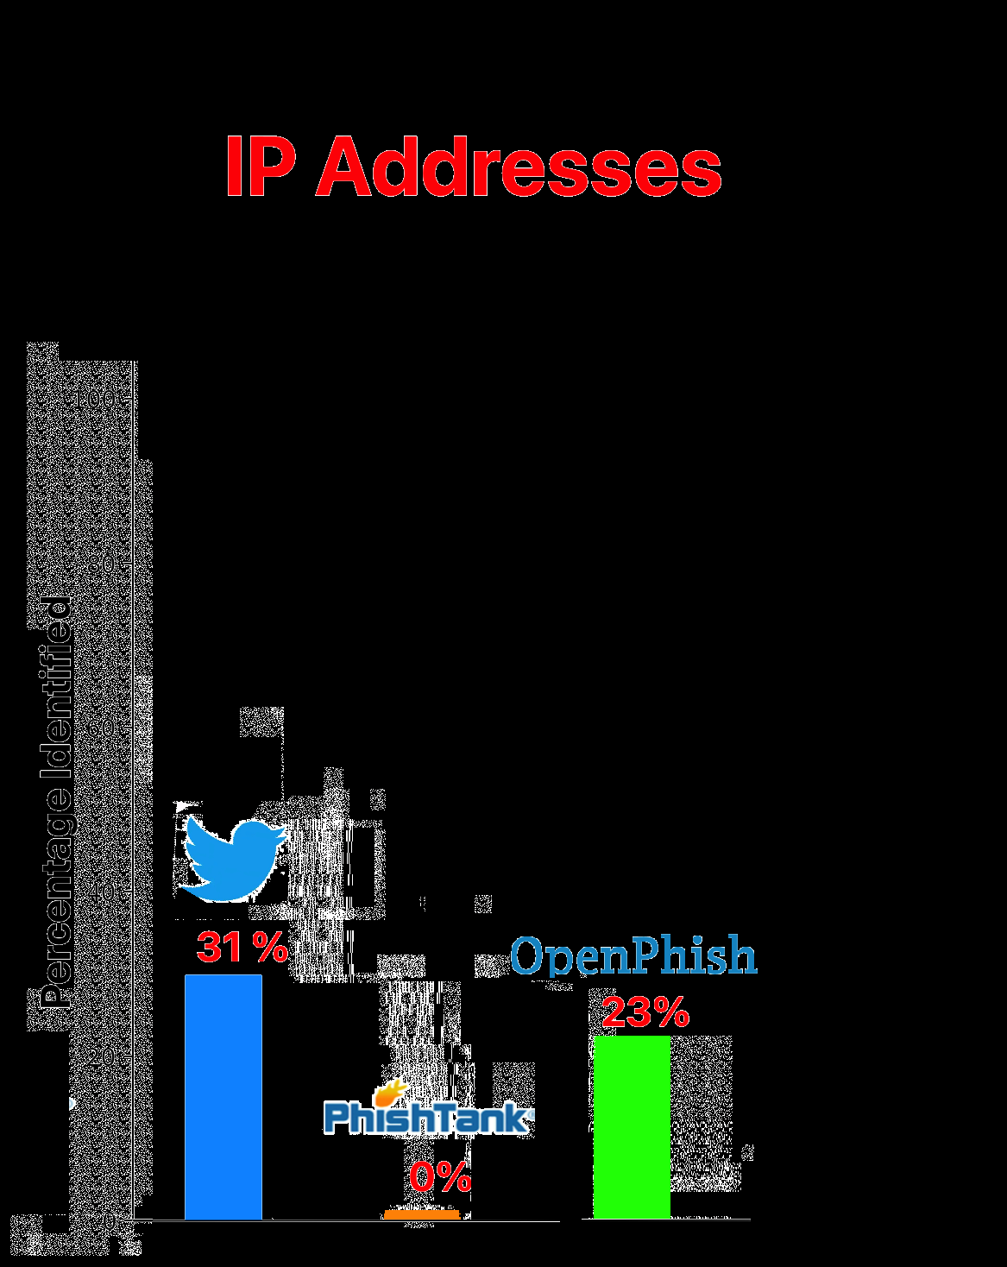
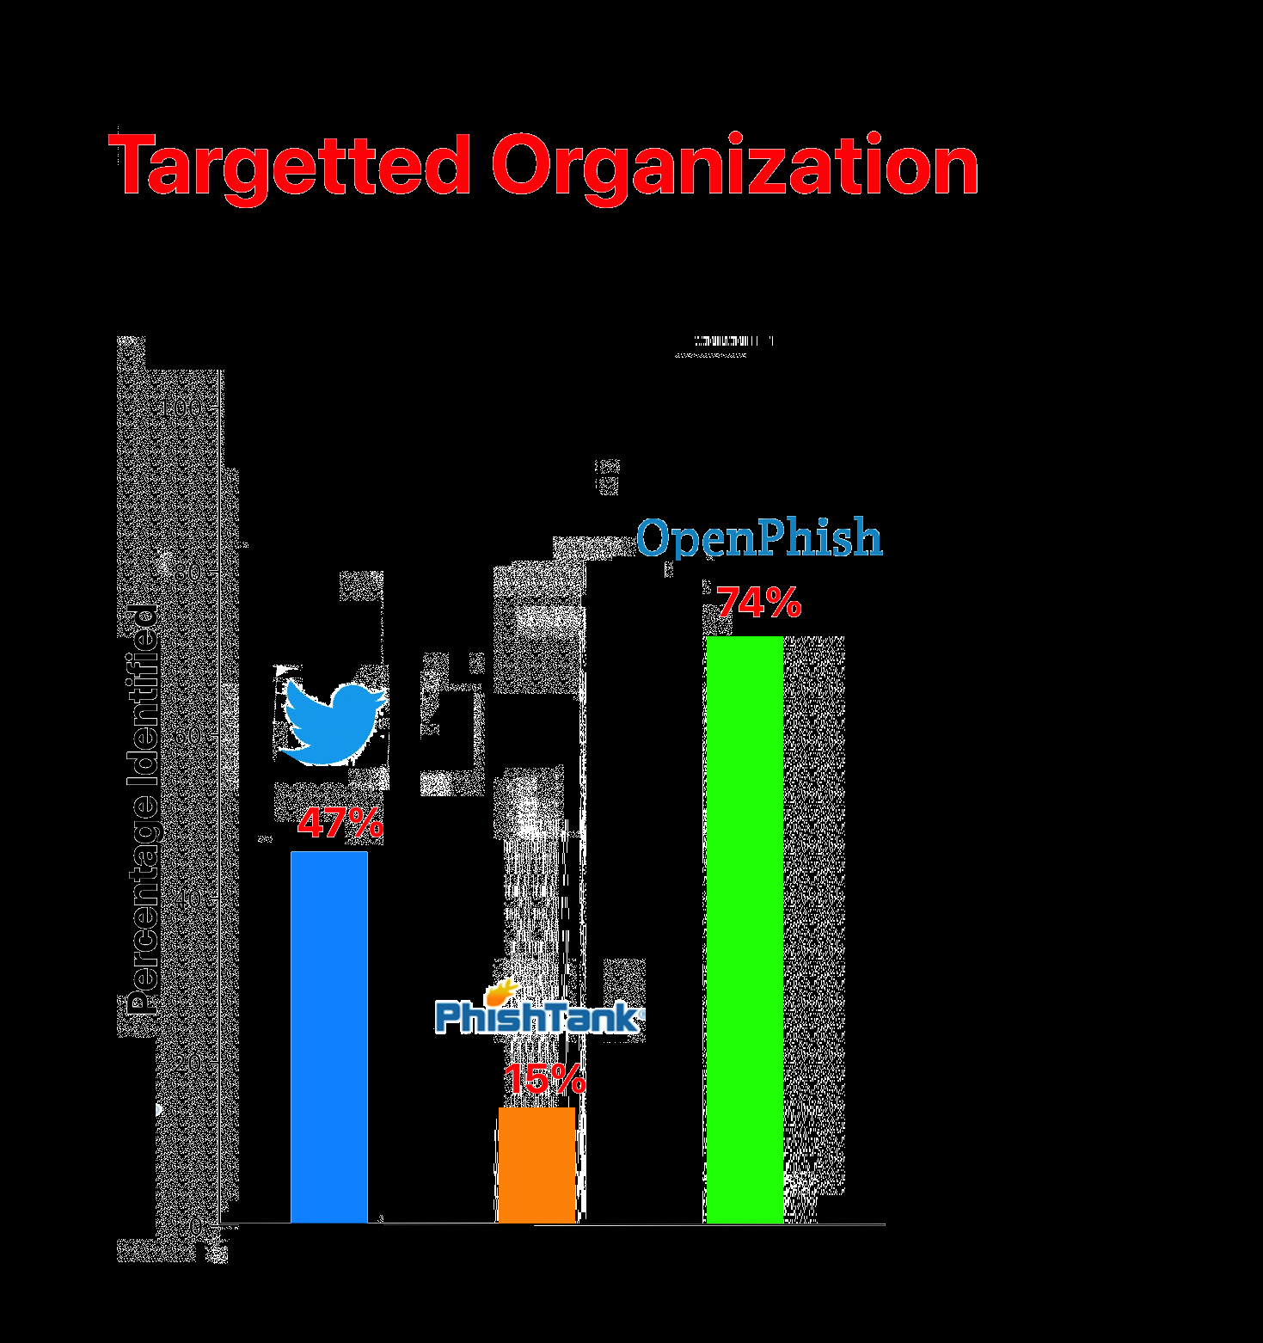
A comparison of information shared
Looking at 10k PhishTank and OpenPhish URLs
Notes:
Make slide more understandable. How am I getting these numbers?
Sayak: Bar chart side by side comparison.

Slide 11
A comparison of information shared
Twitter phishing reports are feature rich.
Notes:
Make slide more understandable. How am I getting these numbers?
Sayak: Bar chart side by side comparison.

Slide 12
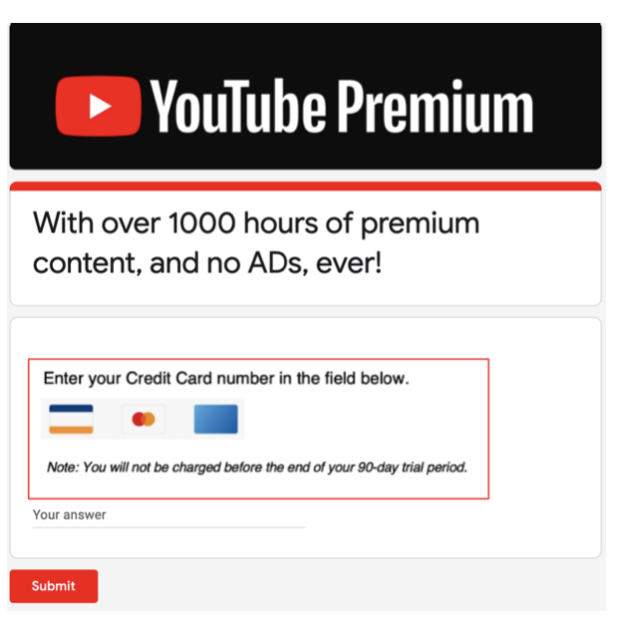
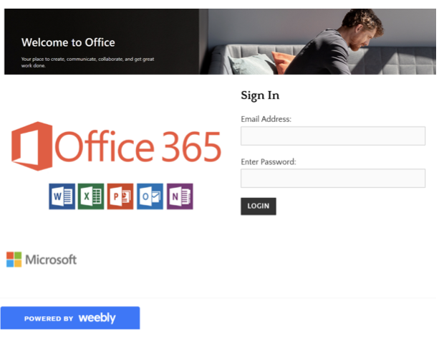
They don’t only cover traditional phishing websites..
New attacks hosted on free website creation services.
Poor detection by both anti-phishing tools and phishing blocklists alike.
Remained active for several months.
Roy, Sayak Saha, Unique Karanjit, and Shirin Nilizadeh. "What Remains Uncaught?: Characterizing Sparsely Detected Malicious URLs on Twitter." (2021).
Notes:
Another slide to explain about the free website creation slide.

Slide 13
They don’t only cover traditional phishing websites..
5%
Of Twitter Phishing Reports were about these new form of threats.
0.2%
Of PhishTank were about these new form of threats.
0.6%
Of OpenPhish were about these new form of threats.
Notes:
Another slide to explain about the free website creation slide.

Slide 14
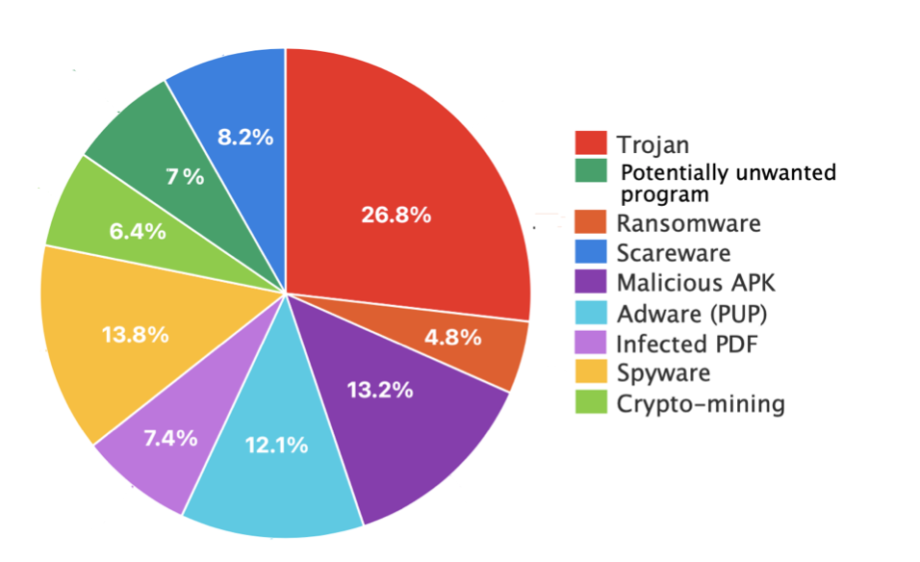
They don’t only cover traditional phishing websites..
7.2% reports about Drive-by downloads, which using Cisco’s cyber trend report, covering over 9 different categories.
0%
PhishTank and OpenPhish do not report Drive-by downloads
Notes:
Another slide to explain about the free website creation slide.

Slide 15
But are these reports reliable?
Social media is open and is very easy to poison.
Using Papernot’s DT Model + Sharkcop + Manual coding we were able to label all the URLs
7%
of Twitter Phishing Reports were False Positives
[1] https://github.com/npapernot/phishing-detection [2] https://github.com/CaoHoangTung/sharkcop
Notes:
Paper not decision tree model trained on UCI’s phishing ground truth dataset.

Slide 16
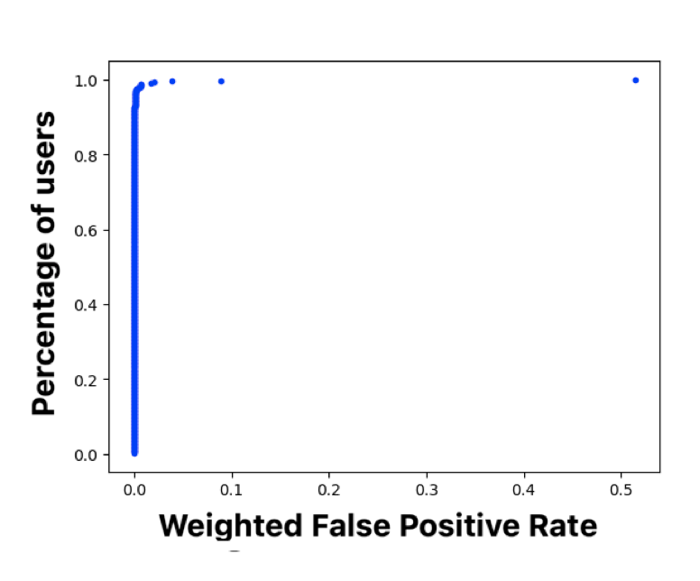
But are these reports reliable?
In fact, when considered individually, each phishing reporter had very low false positive rate.
11% of all false positives originated from one account!
Notes:
Mention most of these false positives came from one account.

Slide 17
On the other hand,
Using the same procedure and analyzing 1k random URLs from PT and OP
20%
of PhishTank reports were False Positives
5%
of Openphish reports were False Positives
Notes:
On Twitter we can identify the accounts,

Slide 18
On the other hand,
PhishTank denotes whether a URL is still active, but is incorrect nearly 33% of the time.
29% of submissions on PhishTank do not contain an usable screenshot.
Notes:
On Twitter we can identify the accounts,

Slide 19

Dead on arrival
Phishing reports are not useful if the URLs are already offline.
24% of URLs on PhishTank were inactive as soon as they were posted.
11% of URLs on OpenPhish are inactive when they are posted.
3.8%
of Twitter phishing reports URLs were inactive when they were posted.

Slide 20
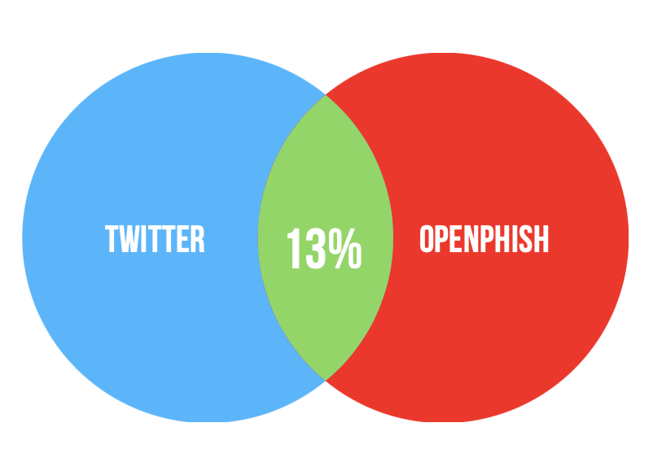
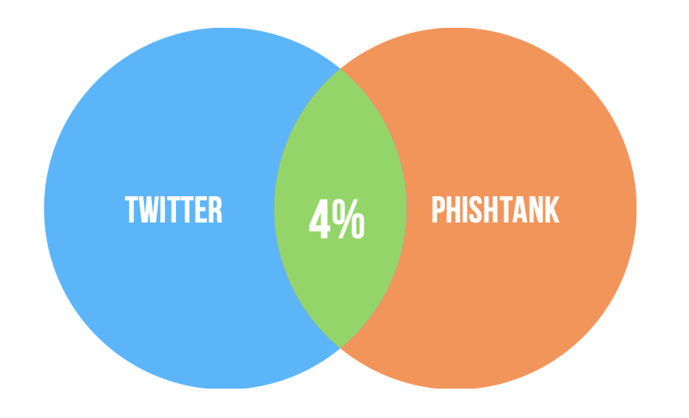
Most of Twitter phishing report URLs are not present on OpenPhish and PhishTank

Slide 21
Phishing reports on Twitter are useful...
Informative
Covers threats outside of just traditional phishing.
Reliable (Lower false positives)
A large volume of URLs which are not covered by PhishTank and OpenPhish.
Notes:
Another slide before which summarizes why phishing reports are useful. Swap title of new slide= title of this slide.

Slide 22
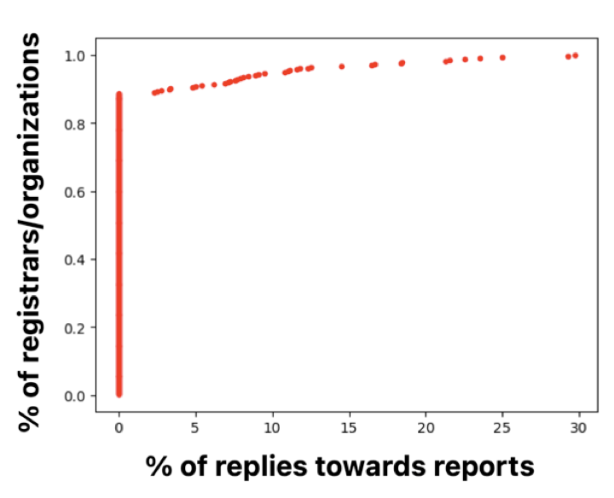
But are Twitter reports having an impact?
Domain registrars have the power to quickly take down websites.
87% of the targeted domains/organizations have a Twitter account (stat)
52% of these phishing reports tagged these accounts.
But only 4% of these reports get interaction (likes, comments, retweets) from the targets and organization.
Notes:
Tagging means the account is notified.
Infact if see this CDF, we see that most accounts do not interact with these reports at all.

Slide 23
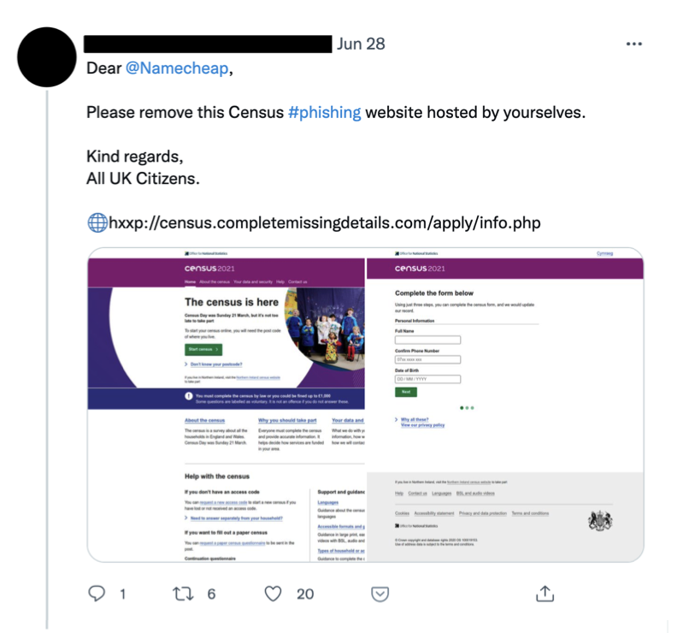
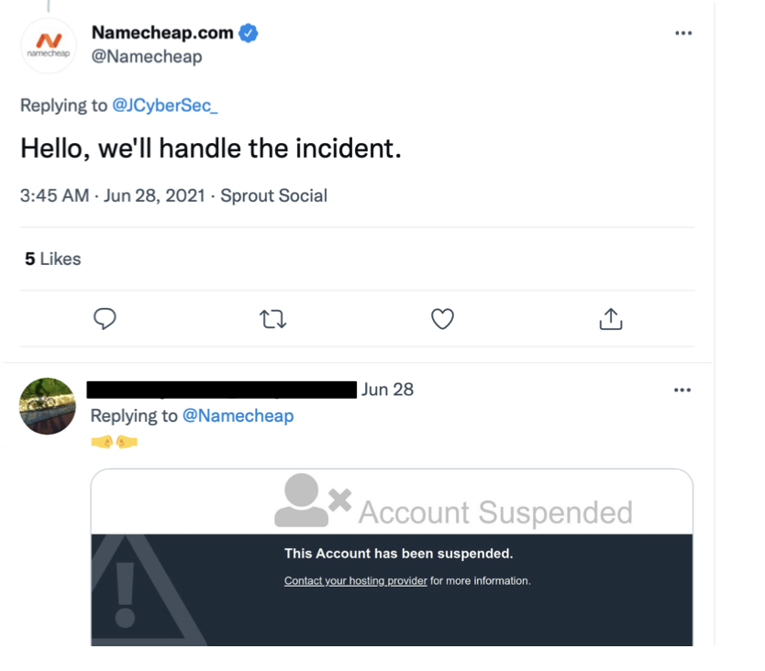
Explicit interaction leads to quick removal
In those 4% of cases that interaction does happen, URLs get removed very quickly, and the organization actually acknowledges it.
Notes:
These are not only comments, they can be likes and replies as well.

Slide 24
The gap in detection and removal
Easiest way to get notifications is to follow these accounts
10% of targets and organizations combined actually follow them.
31% of URLs shared by the reports remained online, even after a week.
Phishing report URLs removed at a much slower pace compared to OpenPhish and PhishTank.

Slide 25
What about regular users?
Similar to organizations, regular users have a 5.2% rate of interaction.
31%
of followers are security conscious users.
Listed count = I want to hear more from you.
However the listed count of phishing reporters is low (1%)

Slide 26
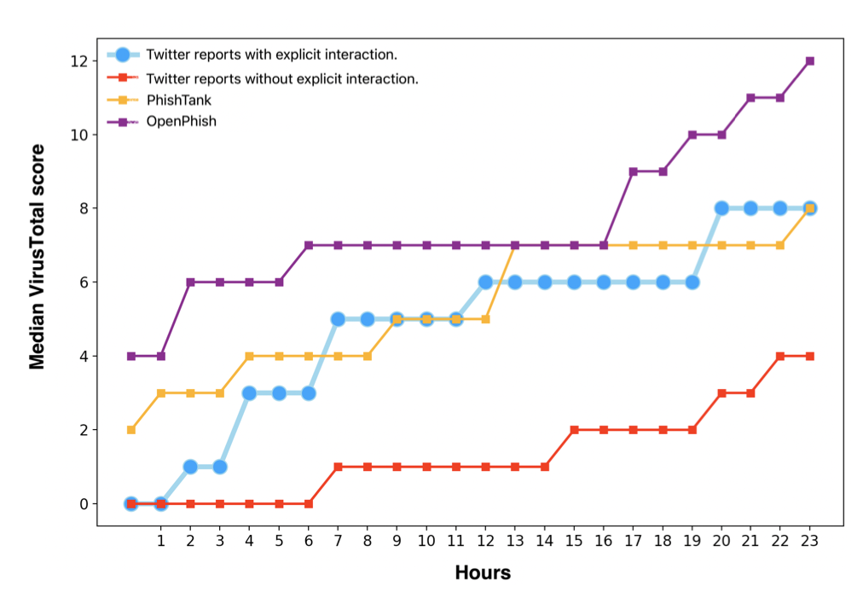
Twitter phishing report URLs have lower detection rate compared to PhishTank and OpenPhish reports
Except, when URLs are explicitly interacted on by organizations or domains, then the detection rate is similar to URLs posted on PT and OP.
Notes:
The curious case of antiphishing detection
URLs posted on PhishTank and OpenPhish detected by several antiphishing engines after being posted.
URLs shared by Twitter phishing reporters have lower detections over time.

Slide 27




Conclusions
Establishing Twitter phishing resources as an informative and reliable source of information.
Outperforms both PhishTank and OpenPhish in various aspects.
But organizations and domains mostly do not interact with these reports.
Need for integration of this open source resource to enhance phishing knowledgebase.

Slide 28


Questions
sayak.saharoy@mavs.uta.edu
@SayakSahaRoy

